Slide 1
بسم الله الرحمن الرحيم

Slide 2
UW-23-ME-BSC-035 Muhammad Khalid

Slide 3
THE POLITICAL SYSTEM OF ISLAM

Slide 4
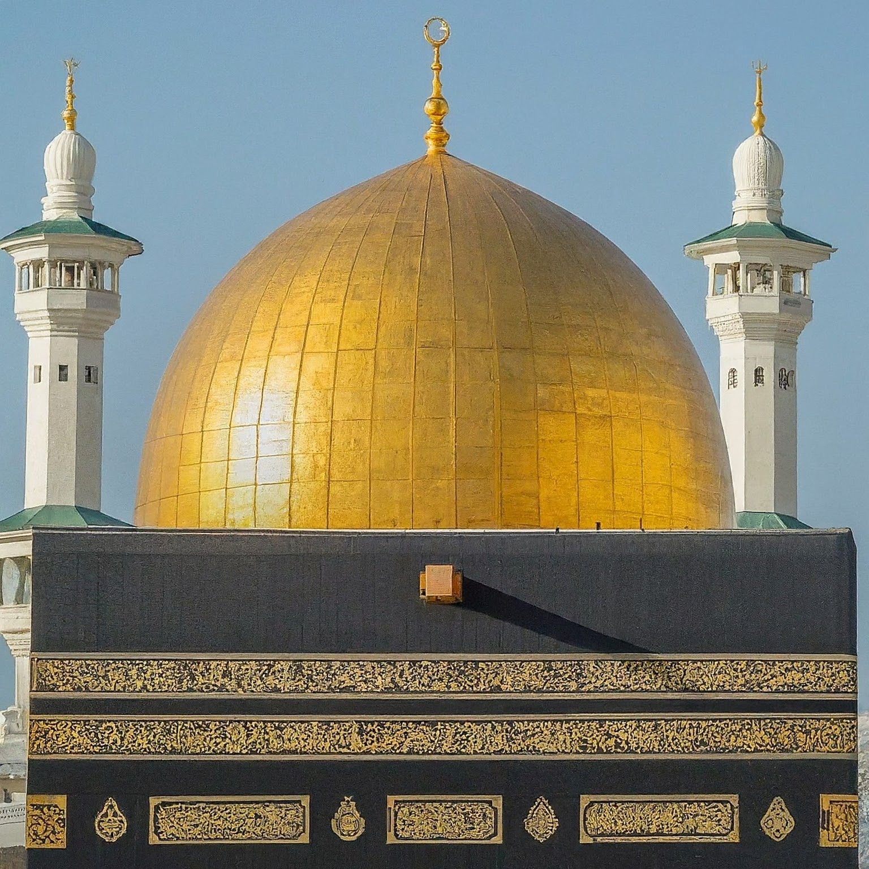
THE POLITICAL SYSTEM OF ISLAM
A GUIDING FRAMEWORK
Notes:
In this presentation, we will explore the concept of a political system in Islam. Islam is not just a religion; it provides a comprehensive way of life, encompassing social, legal, economic, and political spheres. While there is no single, universally agreed-upon form of Islamic government, there are core principles that guide Muslim communities throughout history and today.
Slide 2

Slide 5
SOURCE OF ISLAMIC POLITICAL GUIDENCE
The Quran: The holy book of Islam, believed to be the direct word of God revealed to Prophet Muhammad (PBUH).
The Sunnah: The teachings and practices of Prophet Muhammad (PBUH) as recorded in hadiths.
Ijtihad: The scholarly process of reasoning and interpretation to derive rulings on new issues not explicitly addressed in the Quran and Sunnah.
Notes:
The Quran and Sunnah provide the foundational principles for a just and equitable society. The Quran lays out broad guidelines for leadership, consultation, and the importance of justice. The Sunnah, through the examples of Prophet Muhammad's (PBUH) leadership, offers practical applications of these principles. Ijtihad allows Muslim scholars to address contemporary issues while remaining rooted in Islamic tradition.

Slide 6

CORE PRINCIPLE OF ISLAMIC POLITICAL SYSTEM
Tawhid: Oneness of God. Sovereignty ultimately belongs to God, and all authority is exercised within His divine framework.
Adl (Justice): Establishing justice and fairness for all members of society is a central Islamic principle.
Shura (Consultation): Leaders are encouraged to consult with the community on important matters.
Ummah (Community): Muslims are seen as a global community, with a shared responsibility for well-being.
Khilafah (Caliphate): The concept of a Caliphate, a political leadership for the Muslim world, is historically important but has interpretations and applications debated today.
Notes:
These core principles shape the ideal Islamic political system. Tawhid emphasizes that leadership is a trust from God, and leaders are accountable to Him. Adl ensures equal treatment under the law and the protection of rights. Shura promotes participation and consensus-building in decision-making. The concept of Ummah fosters social cohesion and solidarity. The Caliphate, though historically significant, has no single, universally accepted form in the modern world.

Slide 7
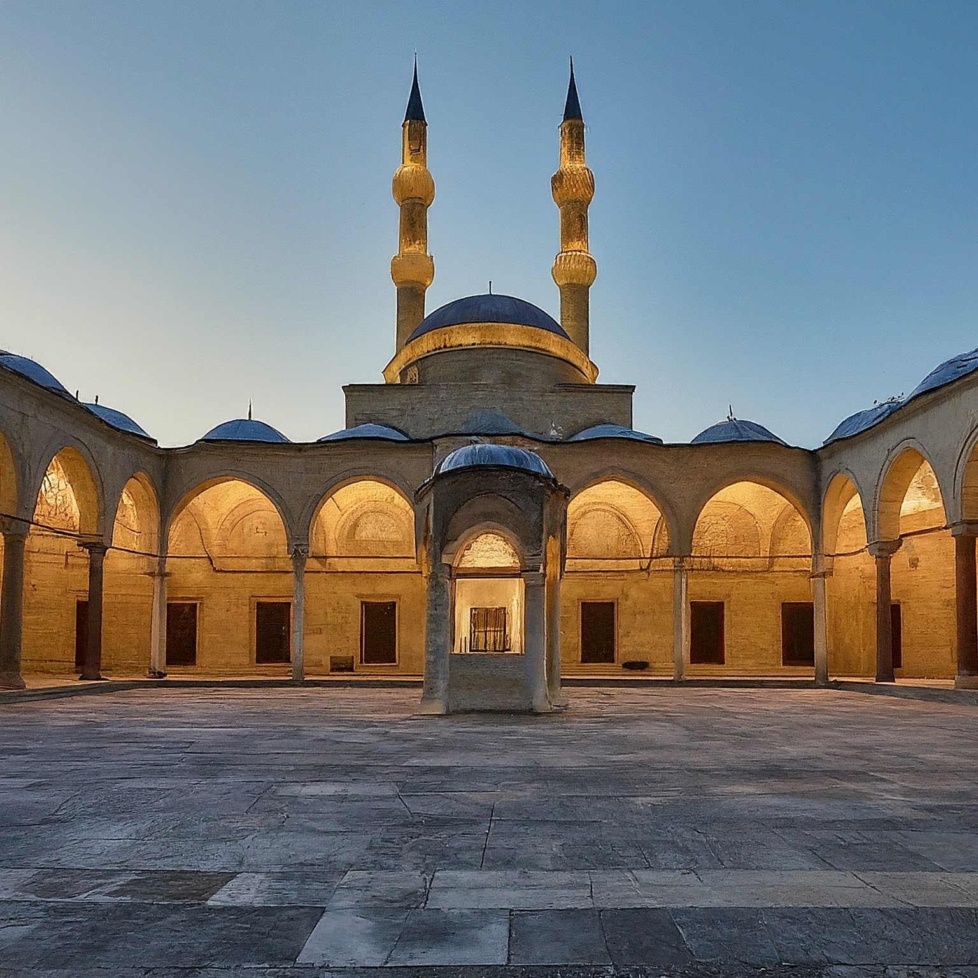
HISTORICAL EXAMPLES OF ISLAMIC GOVERNANACE
The Rashidun Caliphate (Rightly Guided Caliphs): The first four caliphs after Prophet Muhammad (PBUH) are considered models of Islamic leadership.
Umayyad Caliphate: A centralized empire with a strong emphasis on administration and military.
Abbasid Caliphate: A period of flourishing scholarship and cultural exchange.
Ottoman Empire: A long-lasting empire that left a significant mark on the world
Notes:
Islamic history offers various models of governance. The Rashidun Caliphate is often seen as an ideal due to its closeness to the Prophet's (PBUH) time. Later empires, like the Umayyads, Abbasids, and Ottomans, each developed their own political structures while maintaining core Islamic principles.

Slide 8
ISLAMIC POLITICAL SYSTEM IN THE MODREN WORLD
Diverse interpretations and applications: Muslim-majority countries have various political systems, including monarchies, republics, and democracies.
Focus on Islamic values: Many Muslim-majority countries strive to uphold Islamic values like justice, social welfare, and the rule of law within their political structures.
Ongoing debates: There are ongoing discussions about the ideal form of Islamic government in the modern world.
Notes:
The application of Islamic political principles in the modern world is complex and diverse. There's no single model, and Muslim-majority countries have adopted various forms of government. However, a focus on Islamic values like justice, social welfare, and the rule of law remains a common thread. Discussions and debates about the best way to implement these values continue in the Islamic world today.

